Slide 1
Security part
Setting the scene

Slide 2
Security part of module: main topics
Introduction
Threats, attacks, vulnerabilities; Security services
Cryptography
Symmetric encryption
Public key cryptography
Authentication and integrity
Key management and certificates
Web application threats and vulnerabilities
Common vulnerabilities
Penetration testing
Threat modelling
Web application protection
Input validation
Web authentication schemes
Secure key and password storage

Slide 3
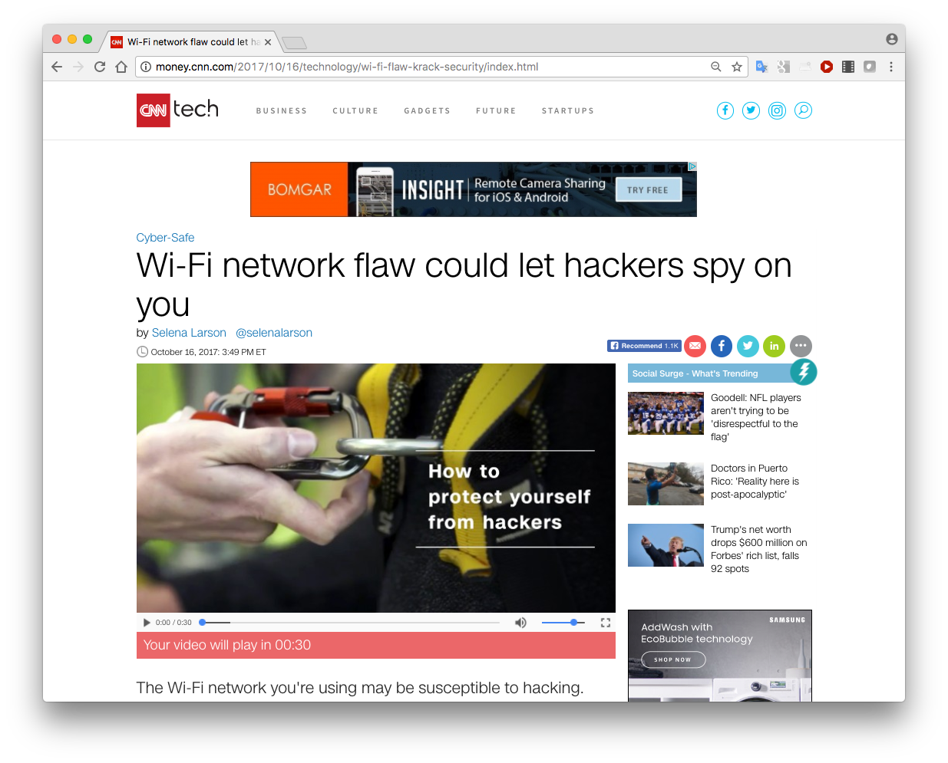
Security news stories…

Slide 4
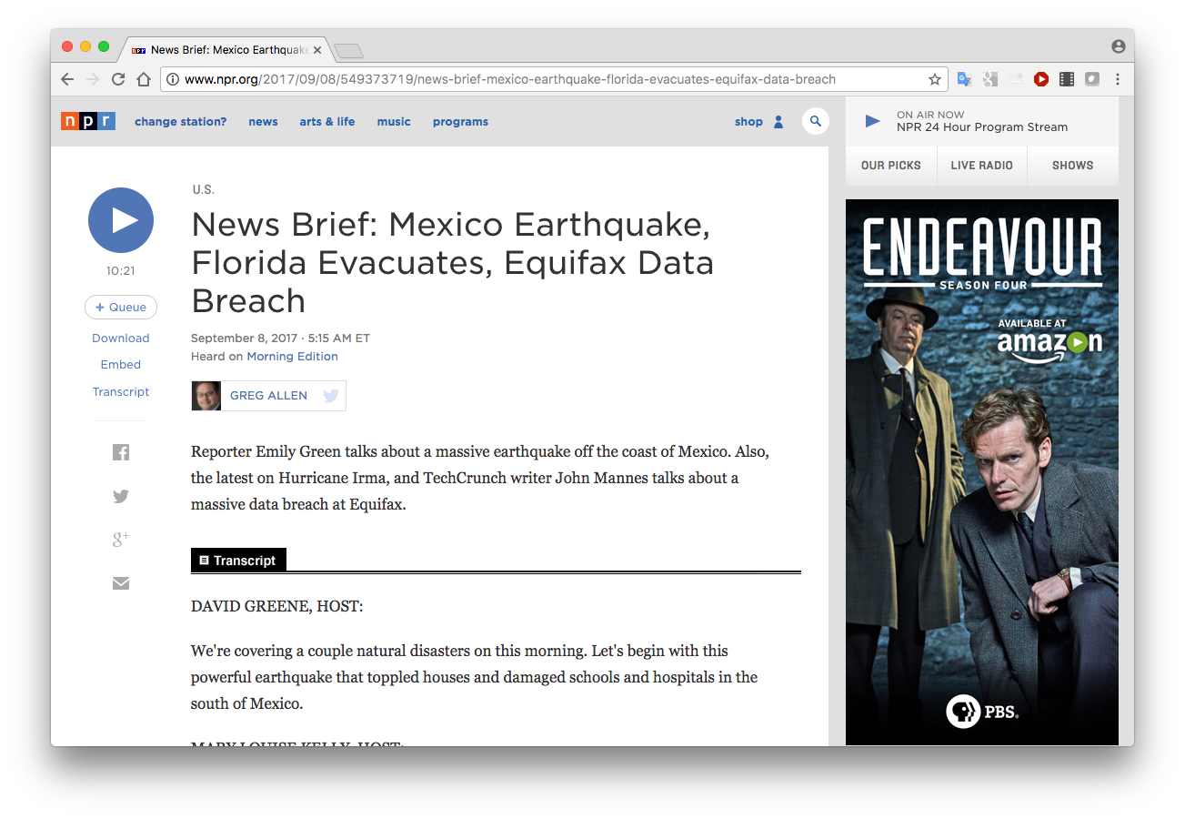
Security news stories…

Slide 5
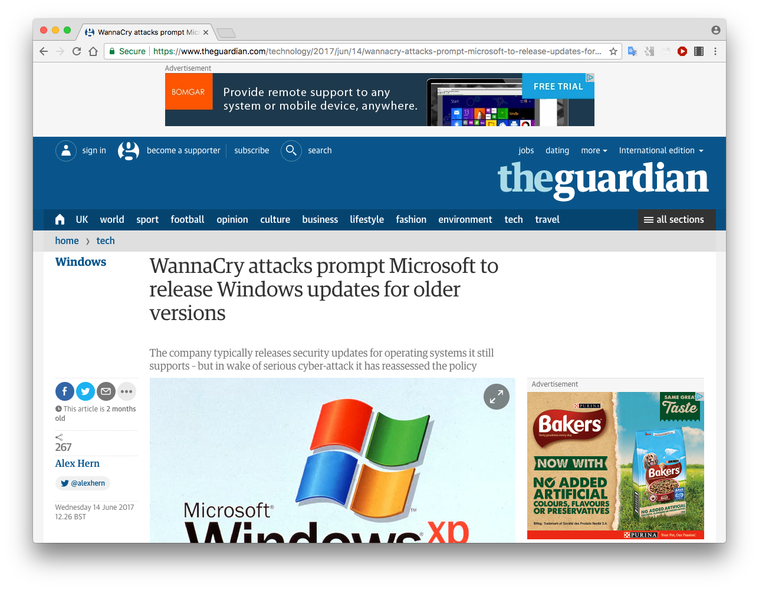
Security news stories…

Slide 6
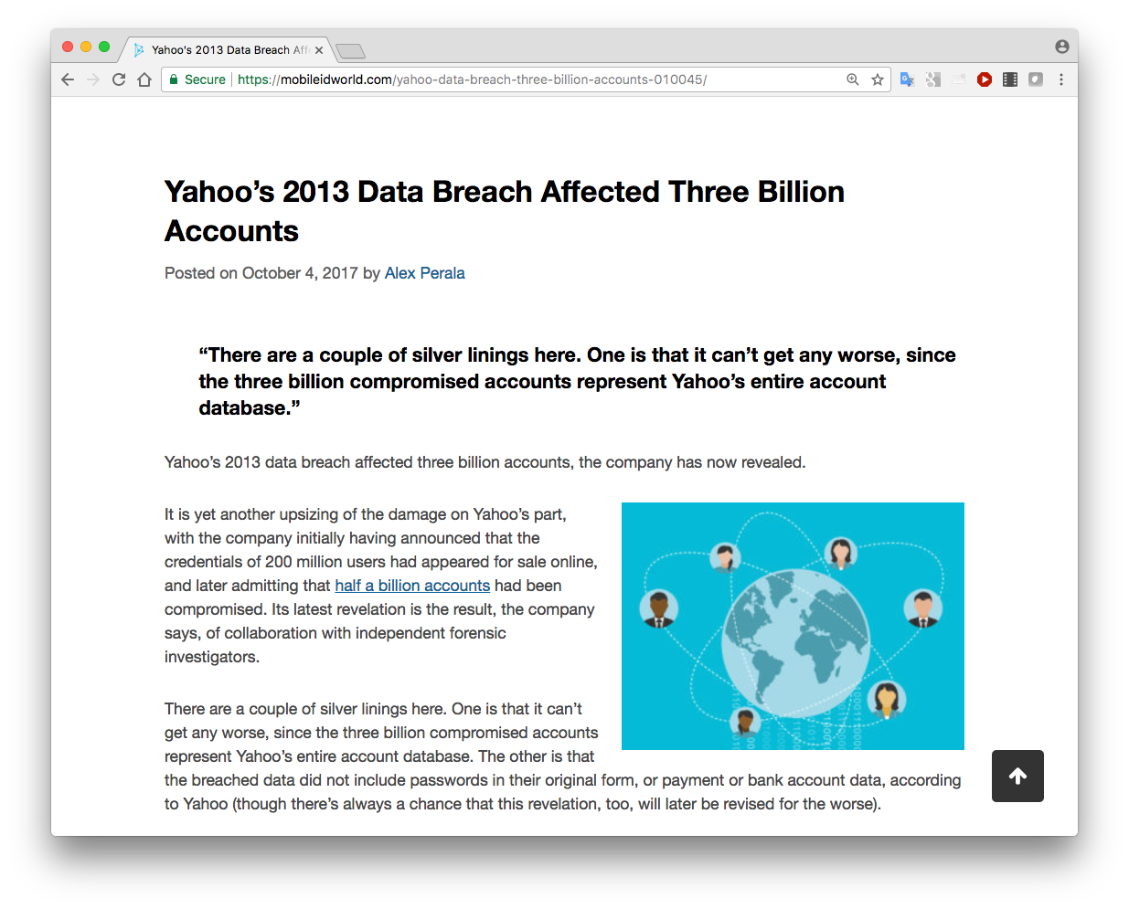
Security news stories…

Slide 7
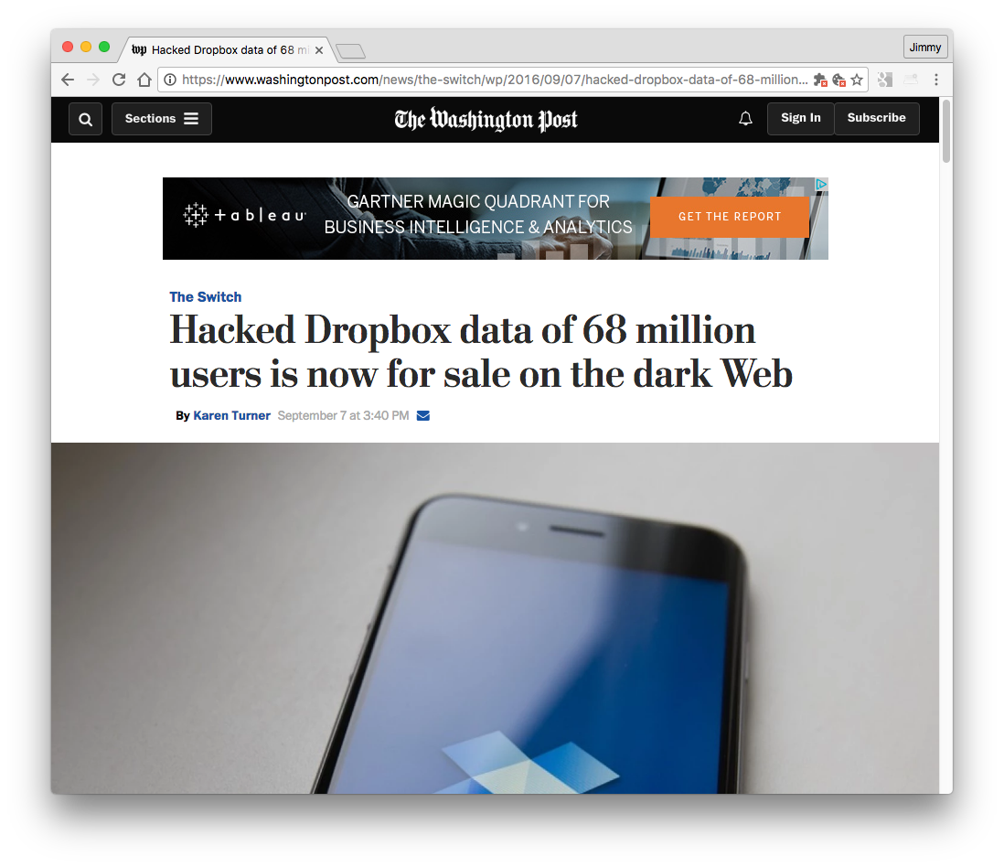
Security news stories…

Slide 8
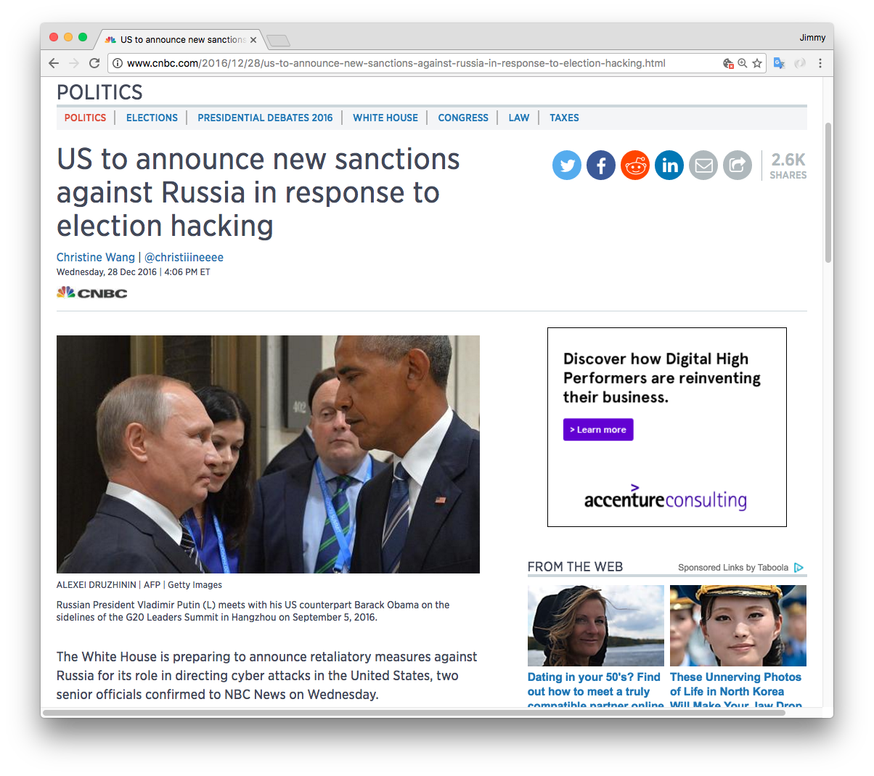
Security news stories…

Slide 9
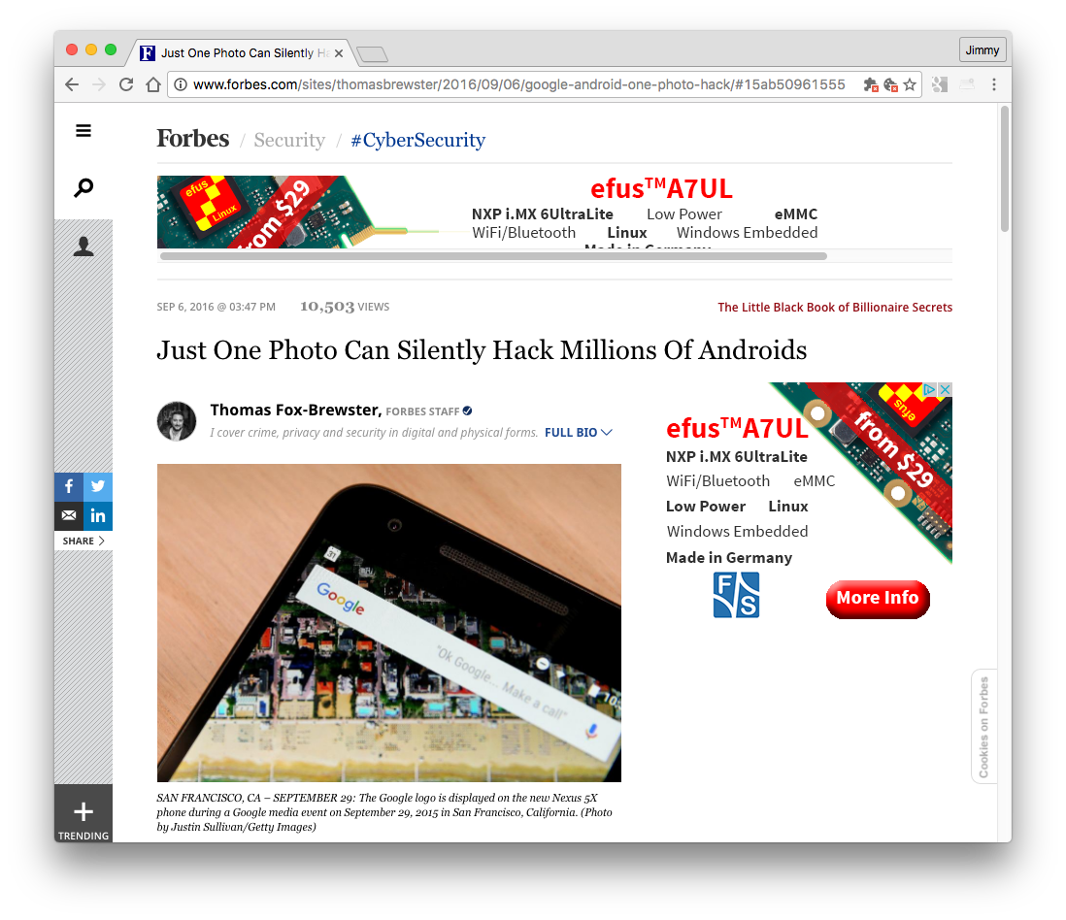
Security news stories…

Slide 10
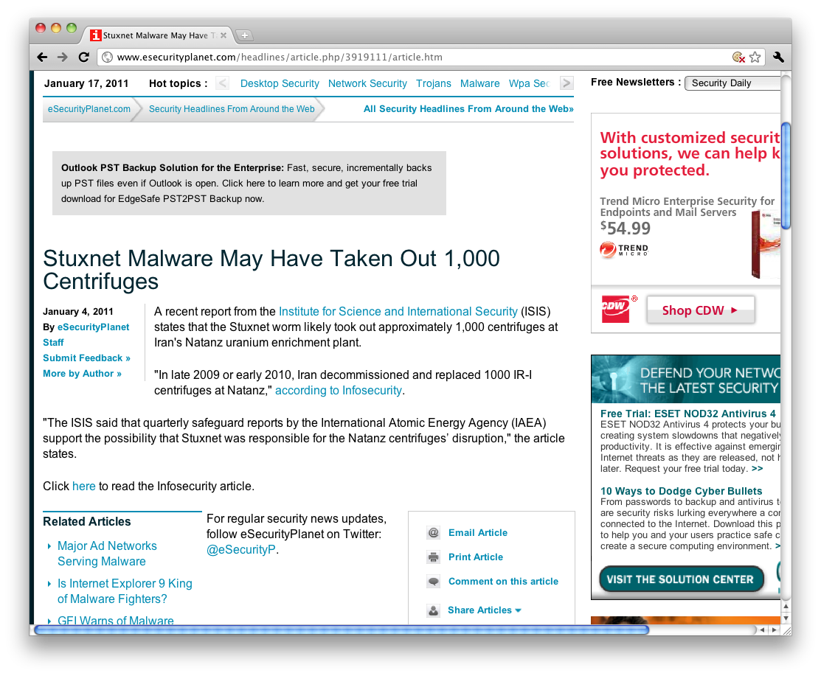
Security news stories…

Slide 11
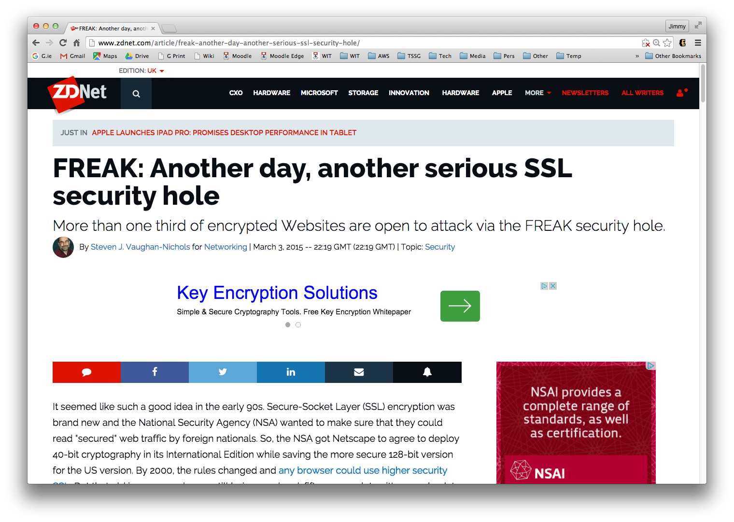
Security news stories…

Slide 12
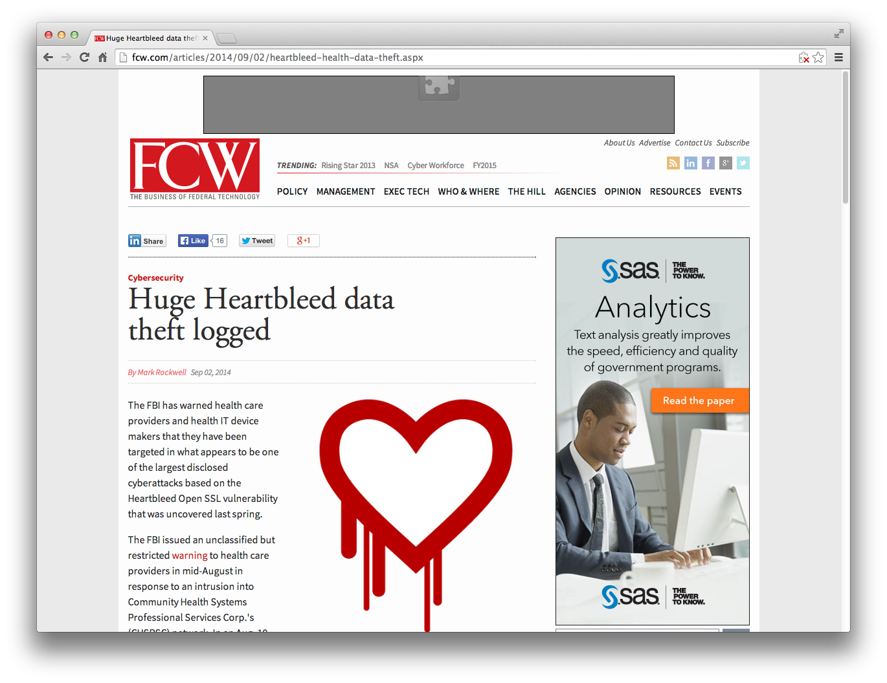
Security news stories…

Slide 13
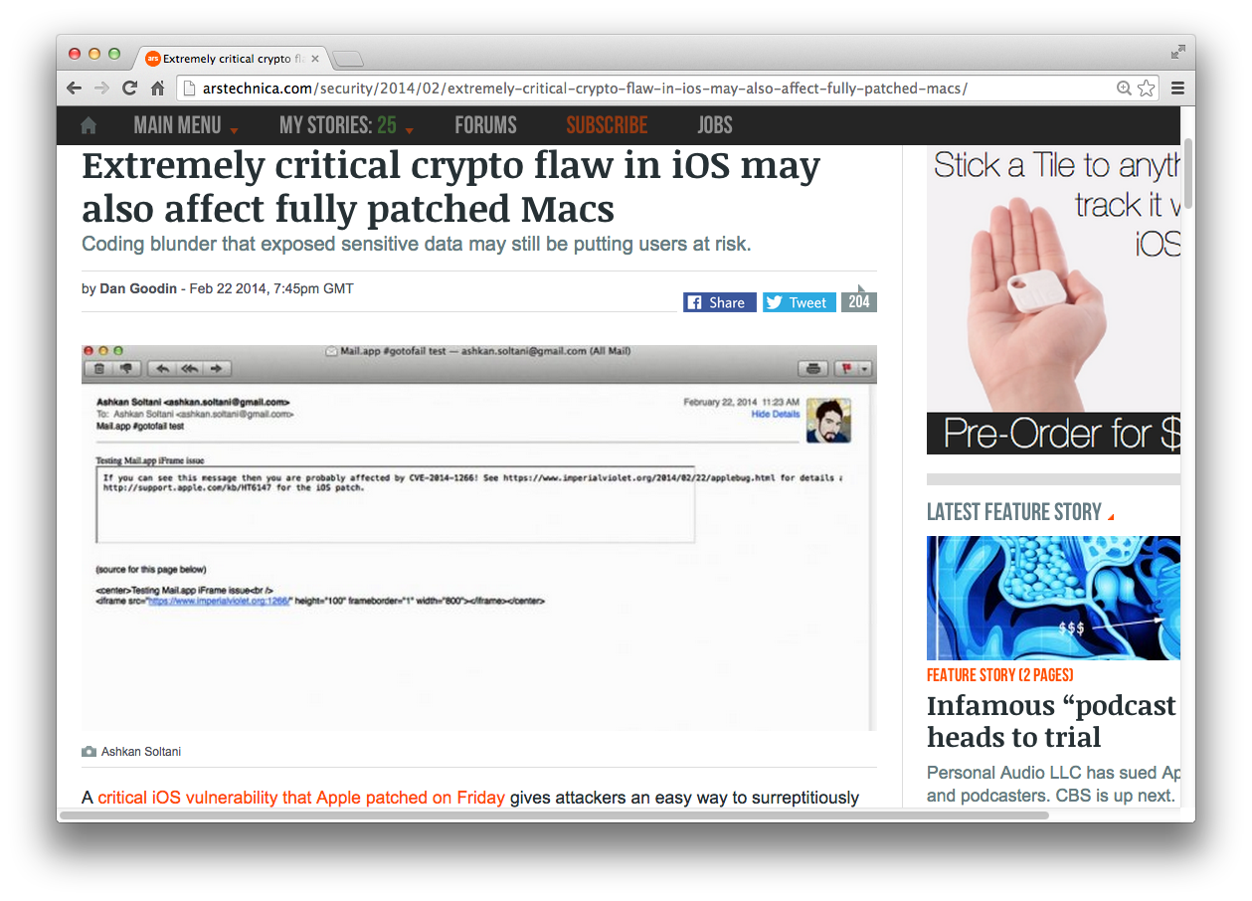
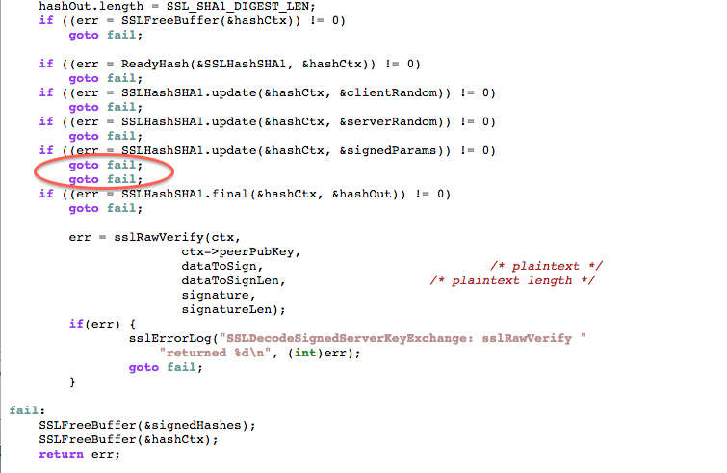
Security news stories…

Slide 14
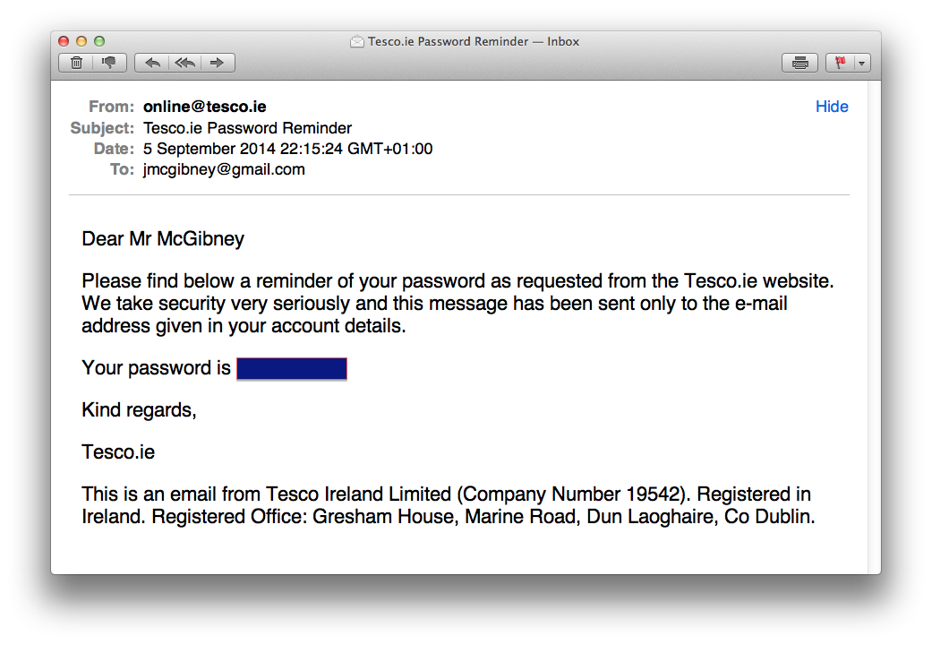
Anything wrong with this?

Slide 15
Anything wrong with this?

Slide 16
Security in context
Increasing reliance on IT & networks for just about everything:
Communications (phone, email, social networks)
Finance
Supply chain (e.g. food on supermarket shelves)
Electricity generation & distribution
Industrial control systems
Water supply
Transportation
How long could we cope without these?

Slide 17
SecurityFocus.com – new vulnerabilities snapshot
2017-08-10 HP Client Automation Remote Code Execution and Stack Buffer Overflow Vulnerabilities 2017-08-10 Microsoft Windows Server Service RPC Handling Remote Code Execution Vulnerability 2017-08-10 Microsoft Internet Information Services CVE-2017-7269 Buffer Overflow Vulnerability 2017-08-10 Oracle Java SE CVE-2017-10081 Remote Security Vulnerability 2017-08-10 GNU Binutils 'bfd/elf.c' Remote Buffer Overflow Vulnerability 2017-08-10 Mercurial Remote Command Injection and Symlink Directory Traversal Vulnerabilities 2017-08-10 Git CVE-2017-1000117 Remote Command Injection Vulnerability 2017-08-10 Apache Tomcat CVE-2017-7674 Security Bypass Vulnerability 2017-08-10 RedHat CVS CVE-2017-12836 Command Injection Vulnerability 2017-08-10 PostgreSQL CVE-2017-7546 Authentication Bypass Vulnerability 2017-08-10 VMware NSX-V Edge CVE-2017-4920 Denial of Service Vulnerability 2017-08-10 PostgreSQL CVE-2017-7547 Information Disclosure Vulnerability 2017-08-10 Linux Kernel CVE-2017-1000111 Local Privilege Escalation Vulnerability 2017-08-10 Apache Tomcat CVE-2017-7675 Directory Traversal Vulnerability 2017-08-10 IBM Sterling B2B Integrator CVE-2017-1174 Unspecified SQL Injection Vulnerability 2017-08-10 Symantec Messaging Gateway CVE-2017-6328 Cross Site Request Forgery Vulnerability 2017-08-10 Microsoft ChakraCore CVE-2017-8658 Scripting Engine Remote Memory Corruption + more (on this day alone)

Slide 18
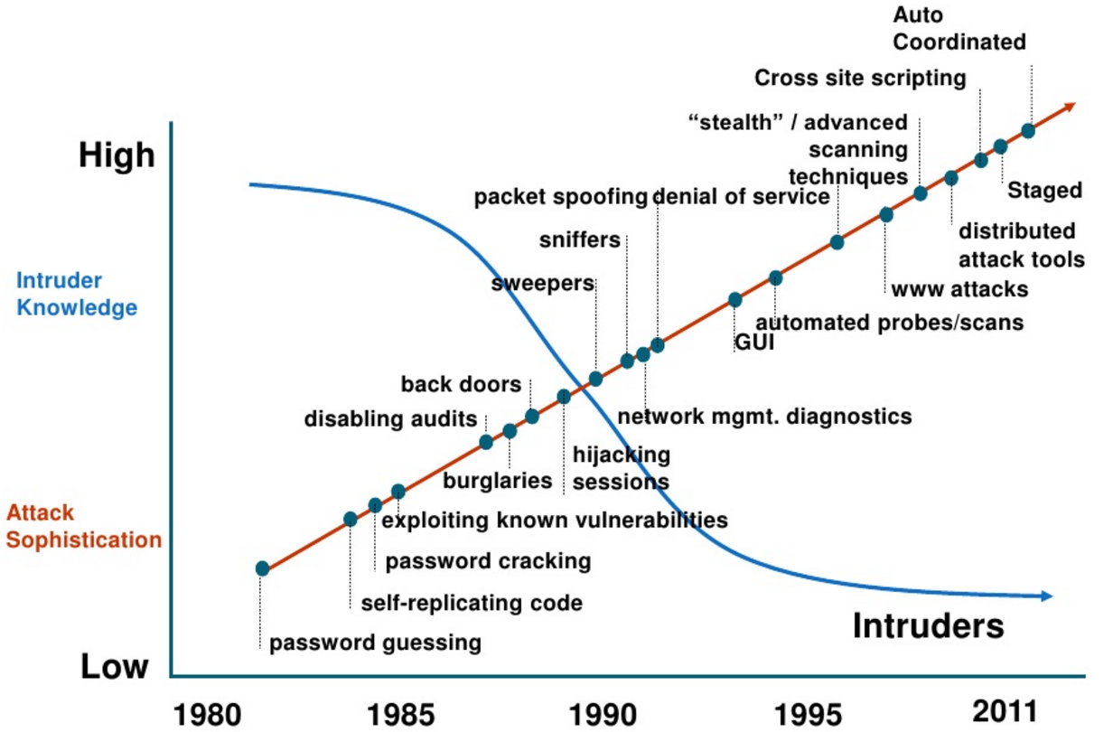
Attack Sophistication vs. Intruder Technical Knowledge
Source: CERT Coordination Center, Pittsburgh

Slide 19
Main players in information security

Slide 20
Main Players in Information Security
Standards Bodies
IETF (Internet Engineering Task Force)
Internet standards, IPsec, SSL/TLS, …
ISO (International Standards Organisation)
OSI model; ISO 27000 series of security standards; "Common Criteria” in ISO 15408
ITU (International Telecoms Union)
Recommendation X.800 on security services
NIST (US Nat’l Institute of Standards & Technology)
Official US standards (called FIPS); many on security
IEEE (Inst of Electrical & Electronics Engineers)
Communication standards, most notably IEEE 802 series: Ethernet (802.3), WiFi (802.11), Authentication (802.1x), …
Industry domain-specific standards and regulations
FDA, PCI DSS, etc

Slide 21
Main Players (continued)
Government agencies
NSA - National Security Agency (US)
in the news a LOT recently
Dept of Homeland Security (US)
Data Protection authorities (powerful in EU countries)
The industry
Software and equipment vendors, web services
Microsoft, Apple, Google, Cisco, Facebook, …
Security vendors, outsourcers, consultants
Symantec, McAfee, RSA Security, Trend Micro, IBM, HP, …
Open source community
OpenSSL, Kali Linux, GPG, OWASP, …
Certificate authorities
VeriSign, DigiCert, Comodo, GeoTrust, GoDaddy, …

